Slide 1
A FOG CENTRIC SECURE CLOUD STORAGE SCHEME
Supervisor
Mrs. P.SHENBAGAM, MCA.,ME,(Ph.D.,)
Head & Assistant Professor,
RVS College of Engineering
Dindigul-624005
Presented By
K.M. ASMATH NASREEN- 921521622006
RVS College of Engineering
Dindigul-624005

Slide 2
ABSTRACT
The storage service is excellent unless users outsource their sensitive data to cloud storage server. Cloud server gets full access and control over user’s data once data is outsourced to the cloud. It can read or search through the user’s data. Recently, fog server based three-layer architecture has been presented for secure storage. In that architecture, the portion of data to be stored in cloud, fog and user’s local machine. Some portion of data in the cloud and their customized hash algorithm, take extra computation/storage overhead, In this project, we create fog-based cloud storage scheme. In that scheme, data is splitted into multiple blocks through xor-combination and combine this blocks into 2-blocks or 3-blocks using xor-operation. So using this scheme, we enhance the efficiency of fog based cloud storage service and improve the security of fog server for a robust fog centric cloud computing infrastructure and we we enhance cypto system to secure data without revealing any information from it.

Slide 3
. INTRODUCTION
In this project, we propose a fog-based cloud storage scheme for data confidentiality, integrity and availability.
For confidentiality and availability (even after malicious events), we propose a method referred to as 𝑋𝑜𝑟−𝐶𝑜𝑚𝑏𝑖𝑛𝑎𝑡𝑖𝑜𝑛 that splits the data into several blocks, combine multiple blocks using Xor operation and outsource the resulted blocks to different cloud/fog servers.
In order to prevent any individual cloud server to retrieve a portion of original data, the proposed technique 𝐵𝑙𝑜𝑐𝑘−𝑀𝑎𝑛𝑎𝑔𝑒𝑚𝑒𝑛𝑡 selects the cloud server to store each particular data blocks

Slide 4
EXISTING SYSTEM
In traditional cloud computing , once users outsource their data to the cloud, they can no longer protect it physically.
Cloud Service Provider (CSP) can access, search or modify their data stored in the cloud storage. At the same time, the CSP may loss the data unintentionally due to some technical faults.
Alternating, a hacker can violate the privacy of the user data. Using some cryptographic mechanisms (such as encryption, hash chain), confidentiality or integrity can be protected. However cryptographic approach cannot prevent internal attacks.

Slide 5
Disadvantages
CSP may loss the data unintentionally due to some technical faults
Cryptographic approach cannot prevent internal attacks

Slide 6
Proposed System
To protect data confidentiality, integrity we propose a fog-based cloud storage scheme for data confidentiality, integrity and availability.
For confidentiality and availability (even after malicious events), we propose a method referred to as Xor-combination that splits the data into several blocks, combine multiple blocks using Xor operation and outsource the resulted blocks to different cloud/fog servers.
We achieve two goals in our project, one is privacy of the data and the other is recoverability of the data in case of data loss. We improve the security of fog server as well as cloud server.

Slide 7
Advantages
• Privacy of the data and the other is recoverability of the data in case of data loss • Improve the security of fog server as well as cloud server

Slide 8
SYSTEM REQUIREMENTS
Hardware Requirements
• Processor | : | Intel(R) Core(TM) i3
• Processor Speed | : | 3.06 GHz
• RAM | : | 2 GB
• Solid Disk Drive | : | 250 GB
• Monitor | : | “17” inches

Slide 9
Software Requirement
• Operating System | : | Windows 7
• Technology Used | : | Microsoft ASP.NET
• Database | : | MySQL
• Database Connectivity | : | ActiveX Data Object (ADO)
• Web Server | : | Internet Information Server
• Browser | : | Internet Explorer 6.0

Slide 10
Modules Description
Storing Procedure
Splitting File
Integrity Processing
Block Management
Cloud Storage
Retrieval Procedure

Slide 11


DATA FLOW DIAGRAM
Home Page
Admin
User
Fog Server
Cloud
Server

Slide 12
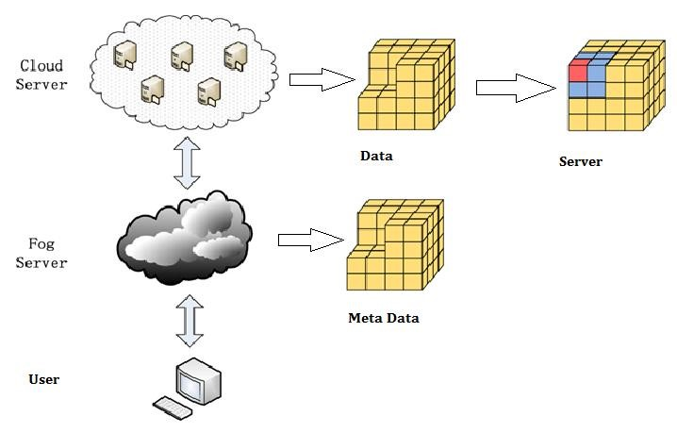
SYSTEM ARCHITECTURE

Slide 13
Screen Shot

Slide 14
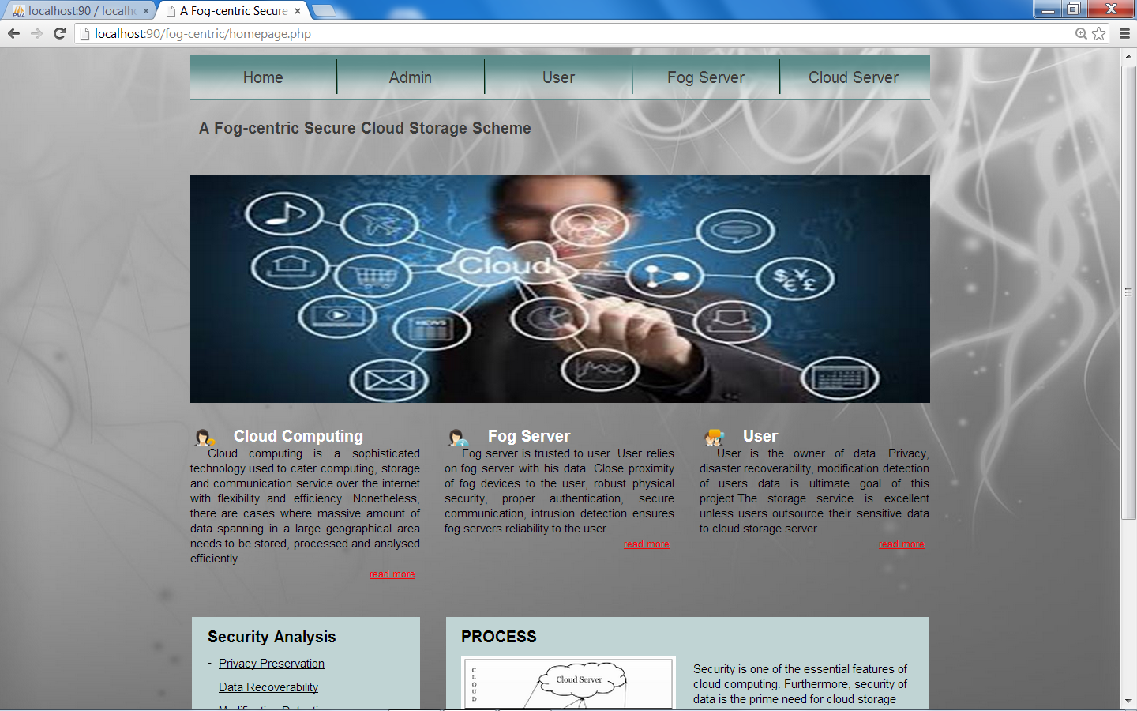
Home Page

Slide 15
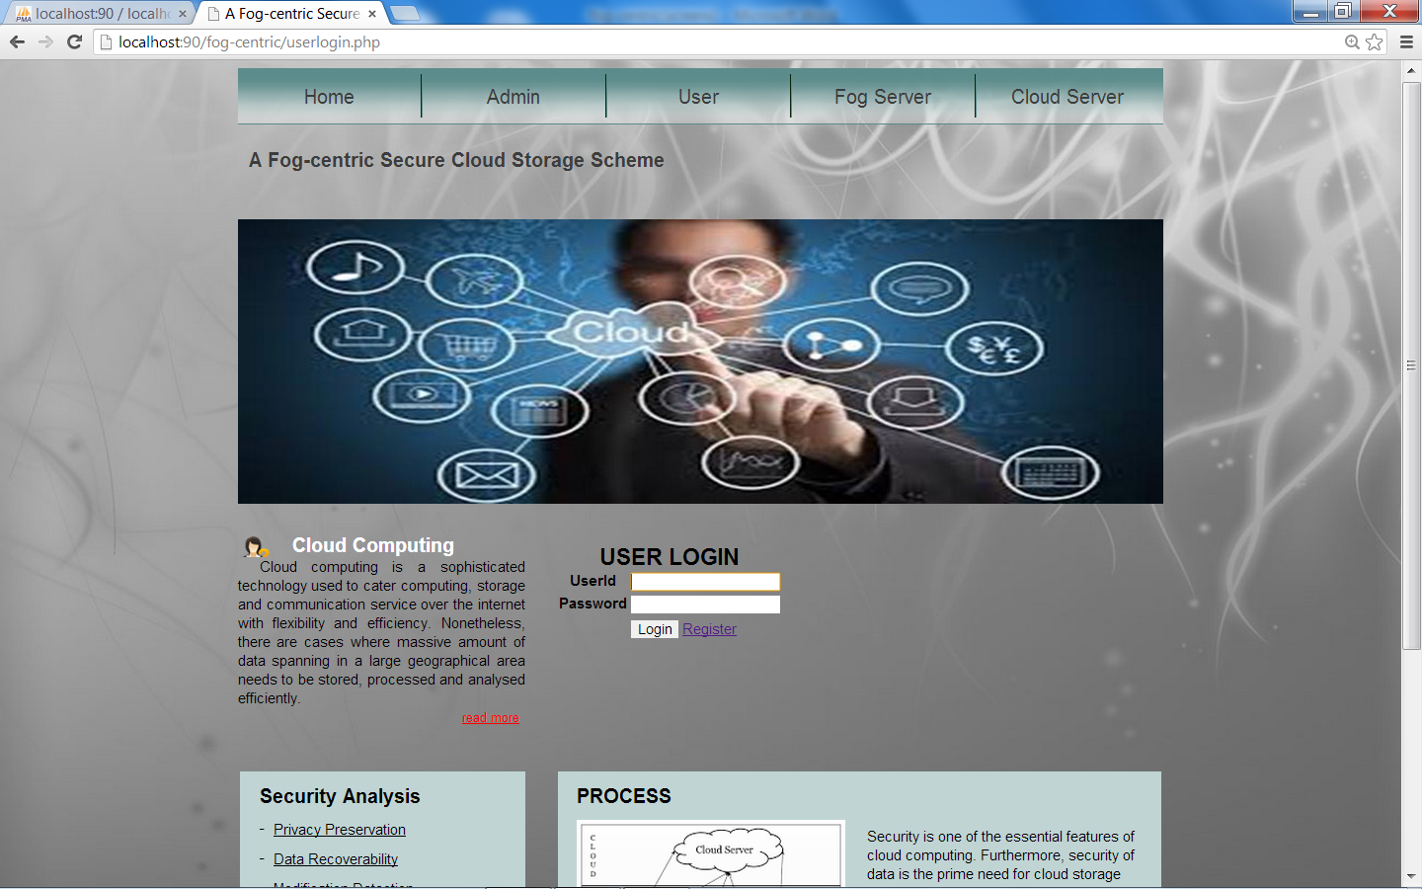
User Registration

Slide 16
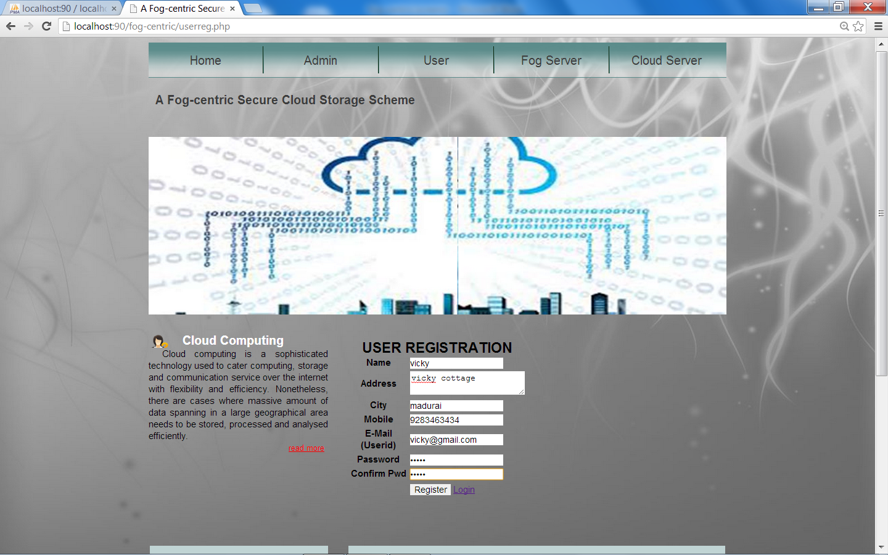
Contd..

Slide 17
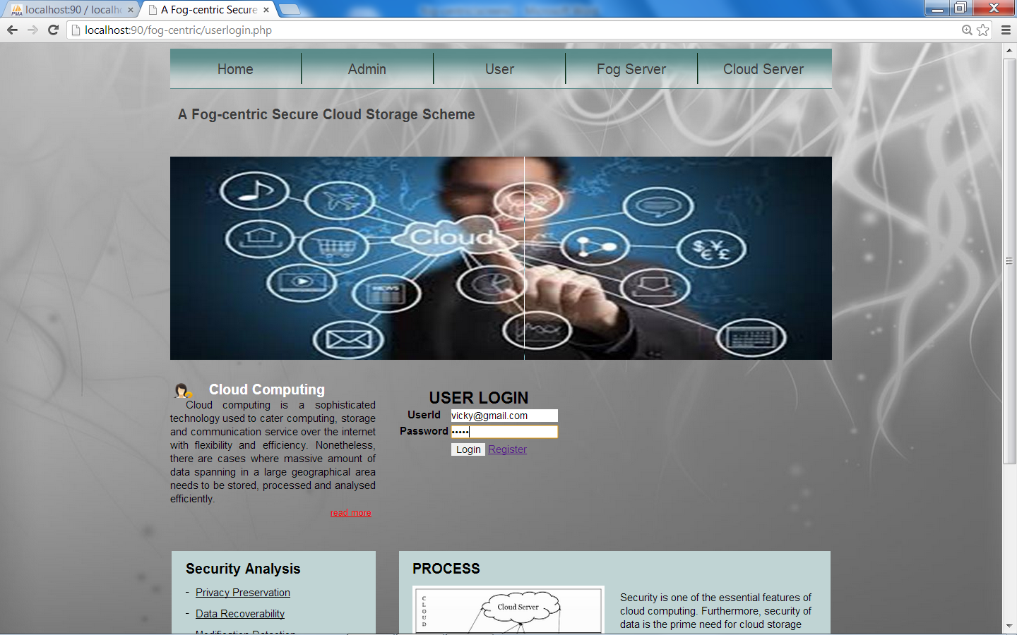
User Login

Slide 18
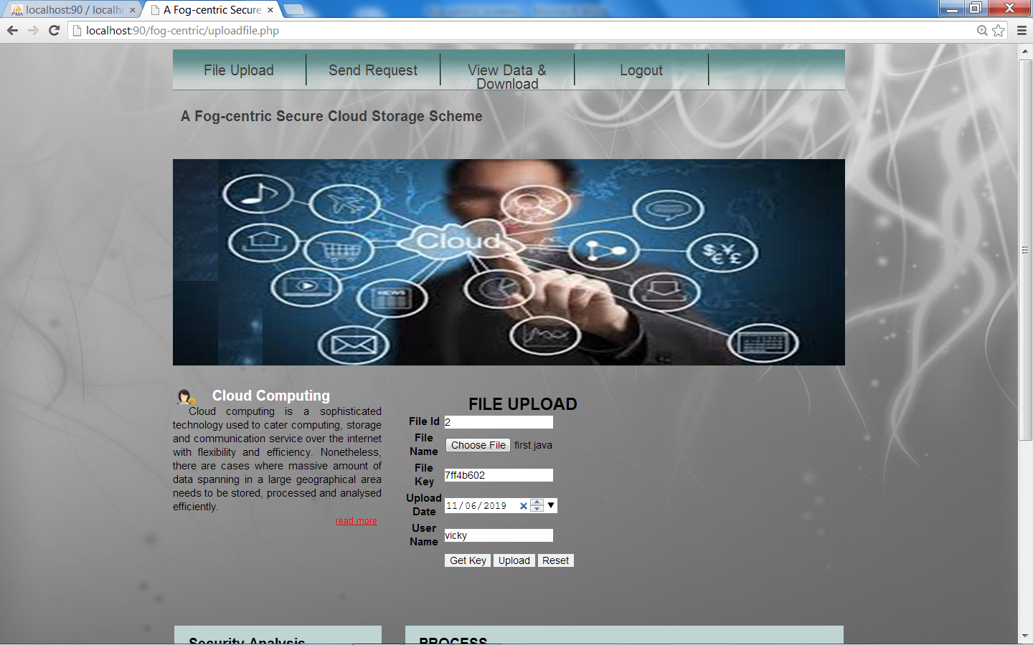
File Upload

Slide 19
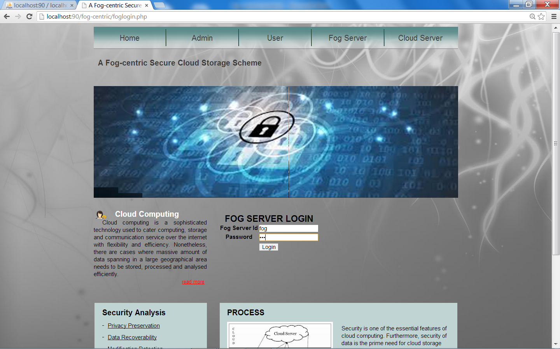
Fog Server Login

Slide 20
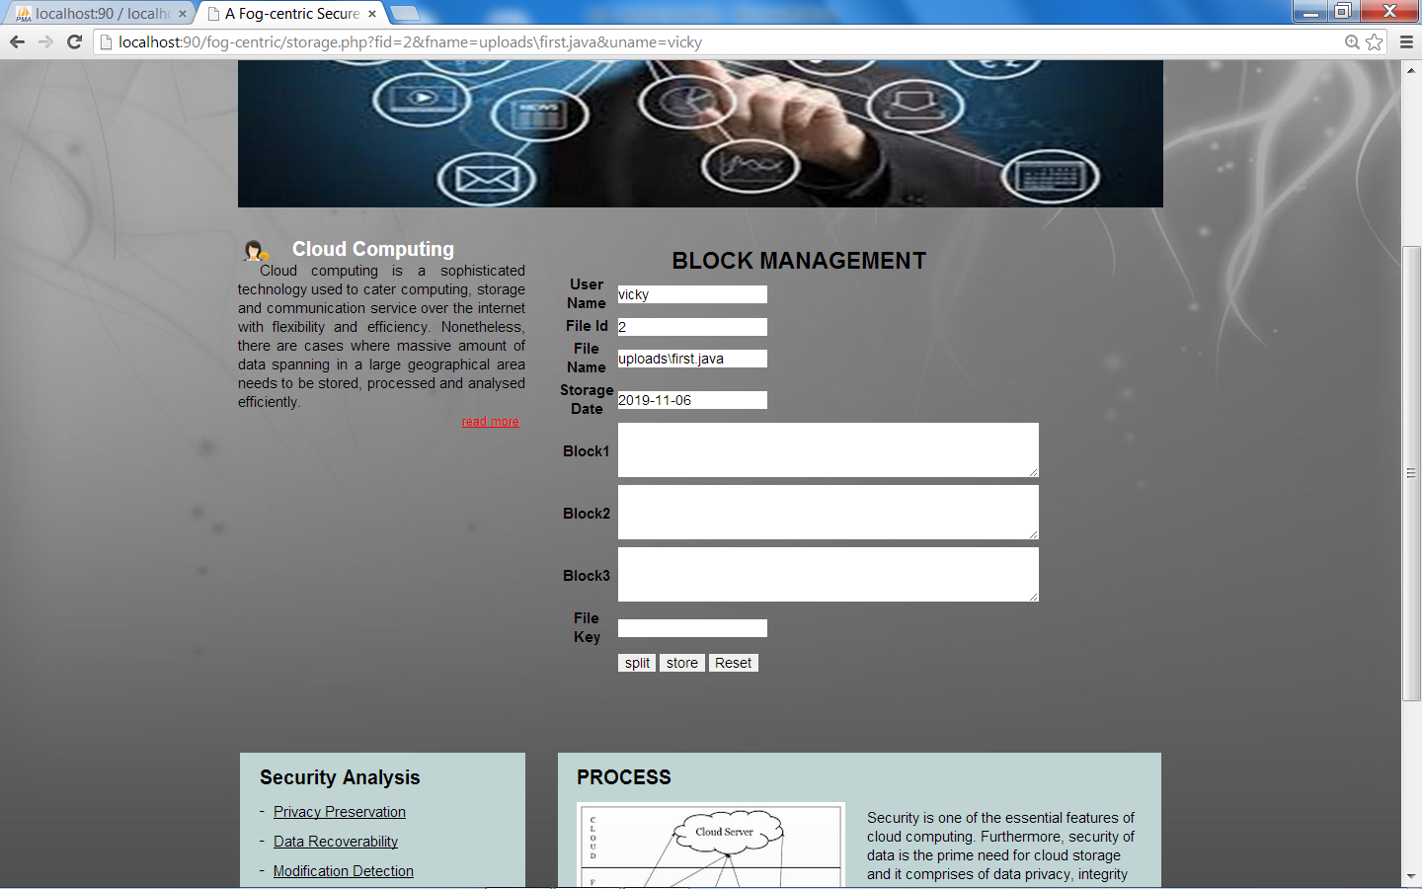
Block Management

Slide 21
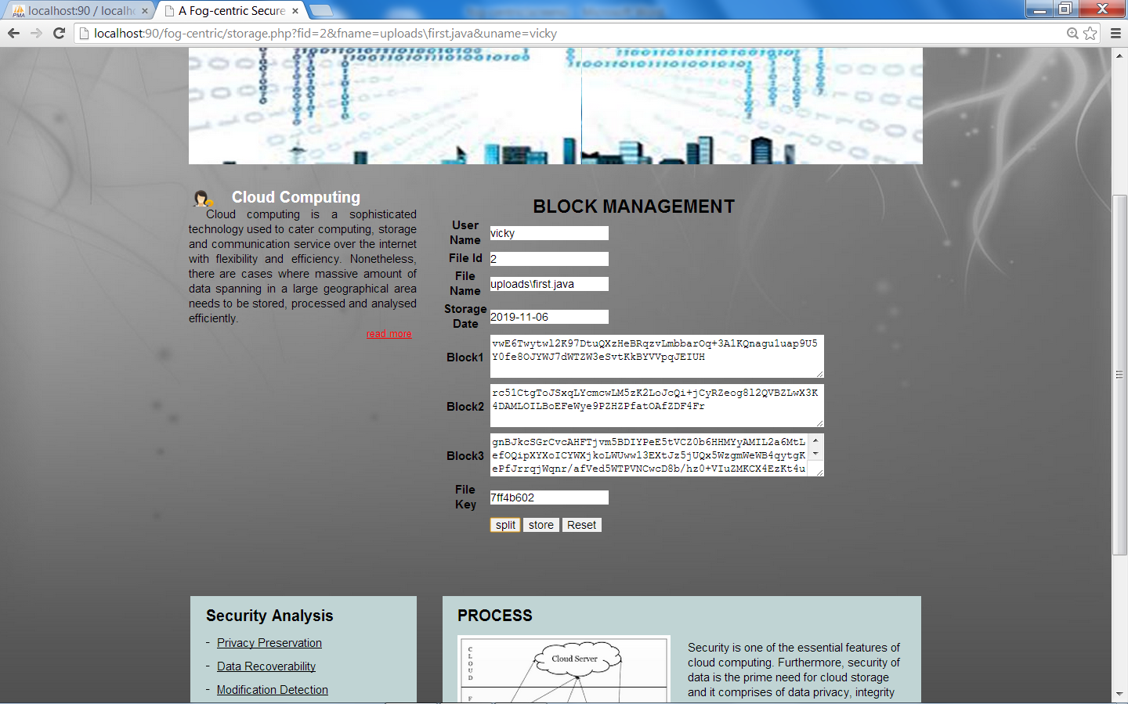
Contd…

Slide 22
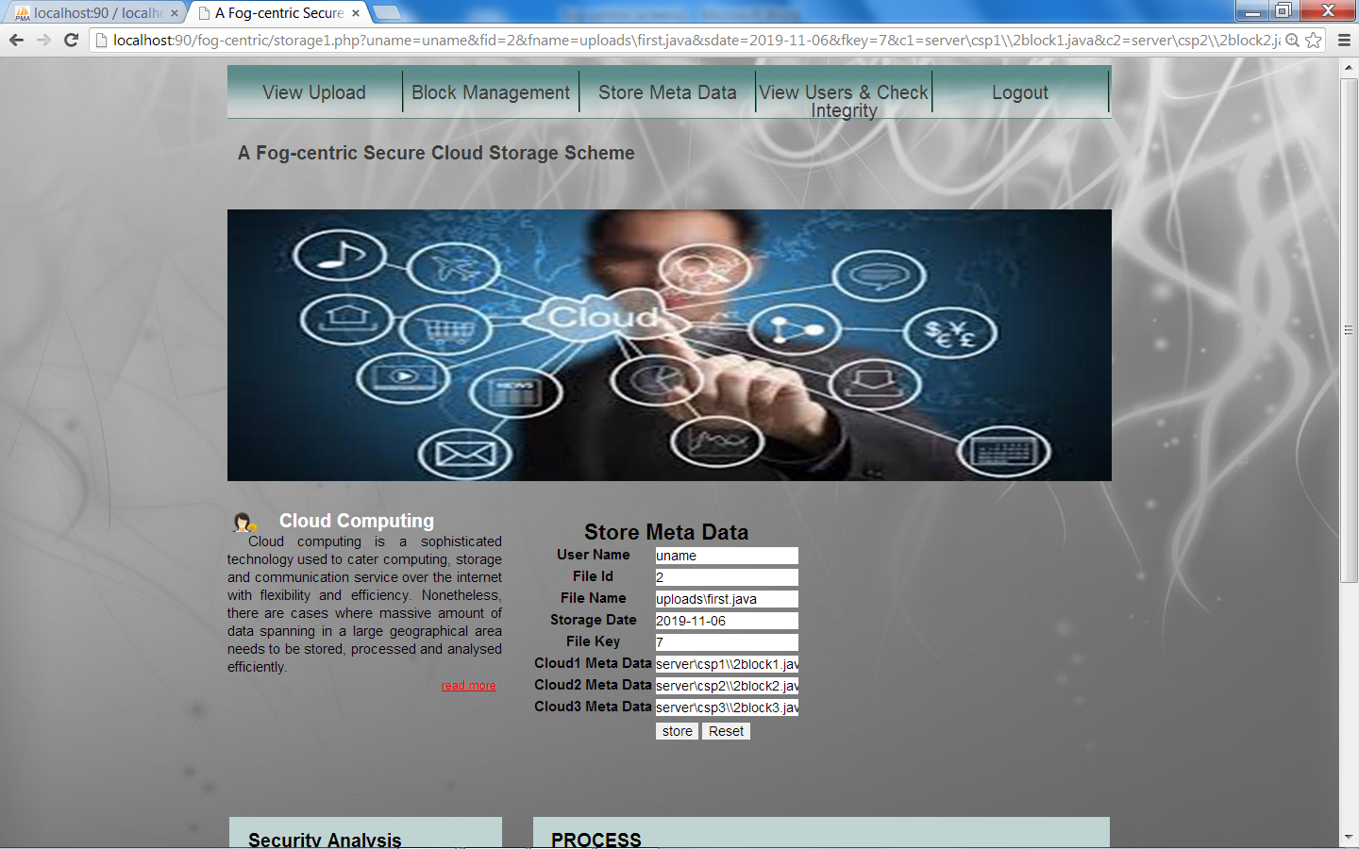
Store Meta Data

Slide 23
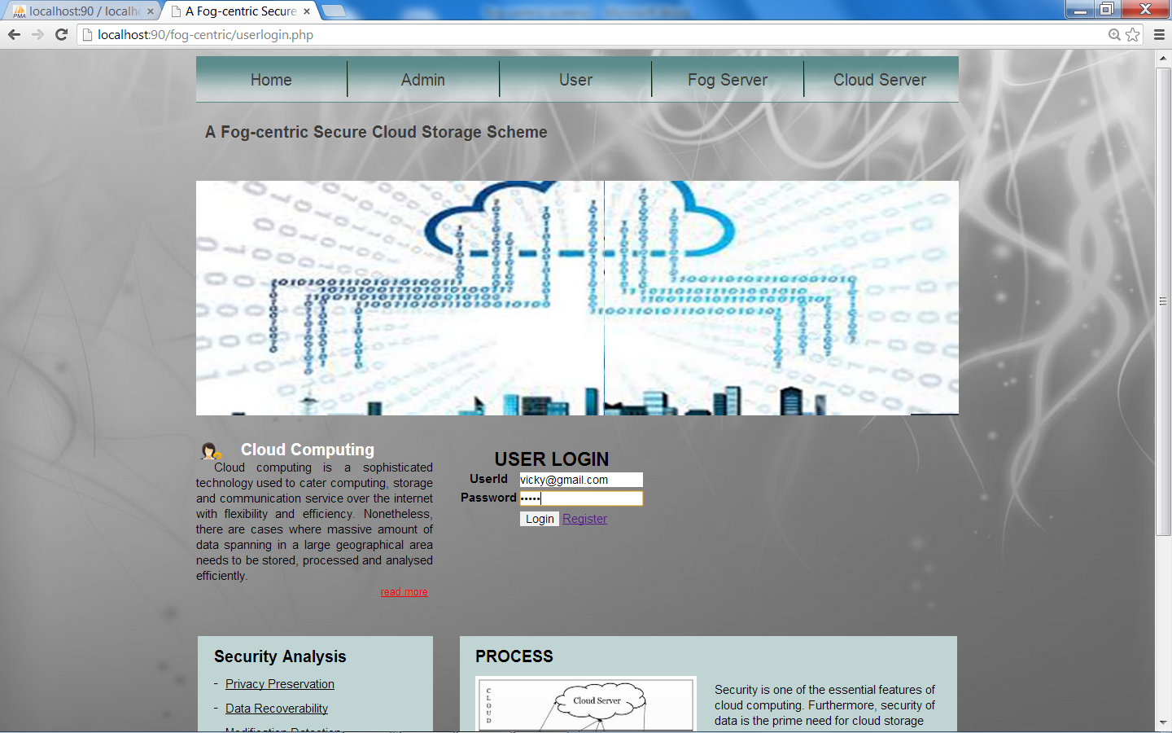
User Login

Slide 24
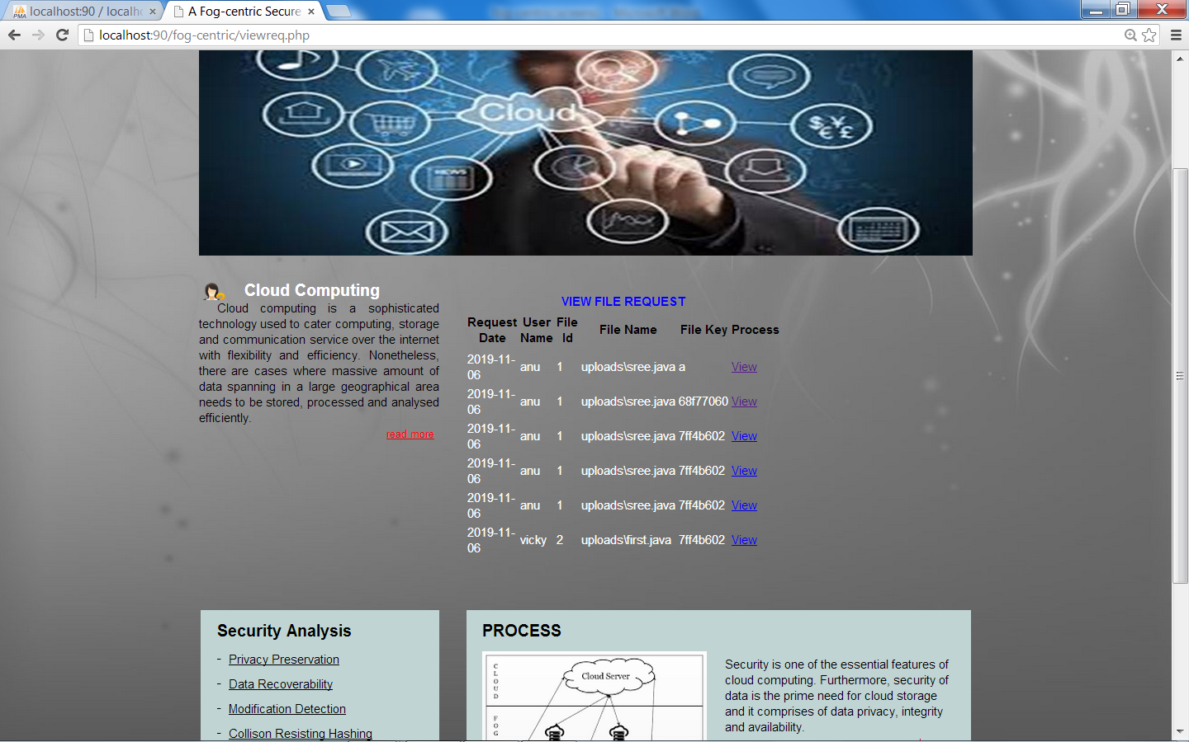
View User & Check Integrity

Slide 25
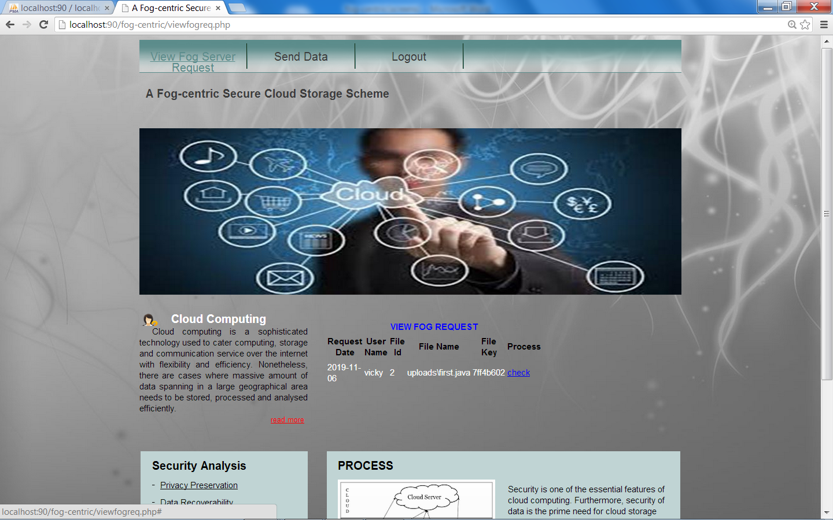
View Fog Server Request

Slide 26
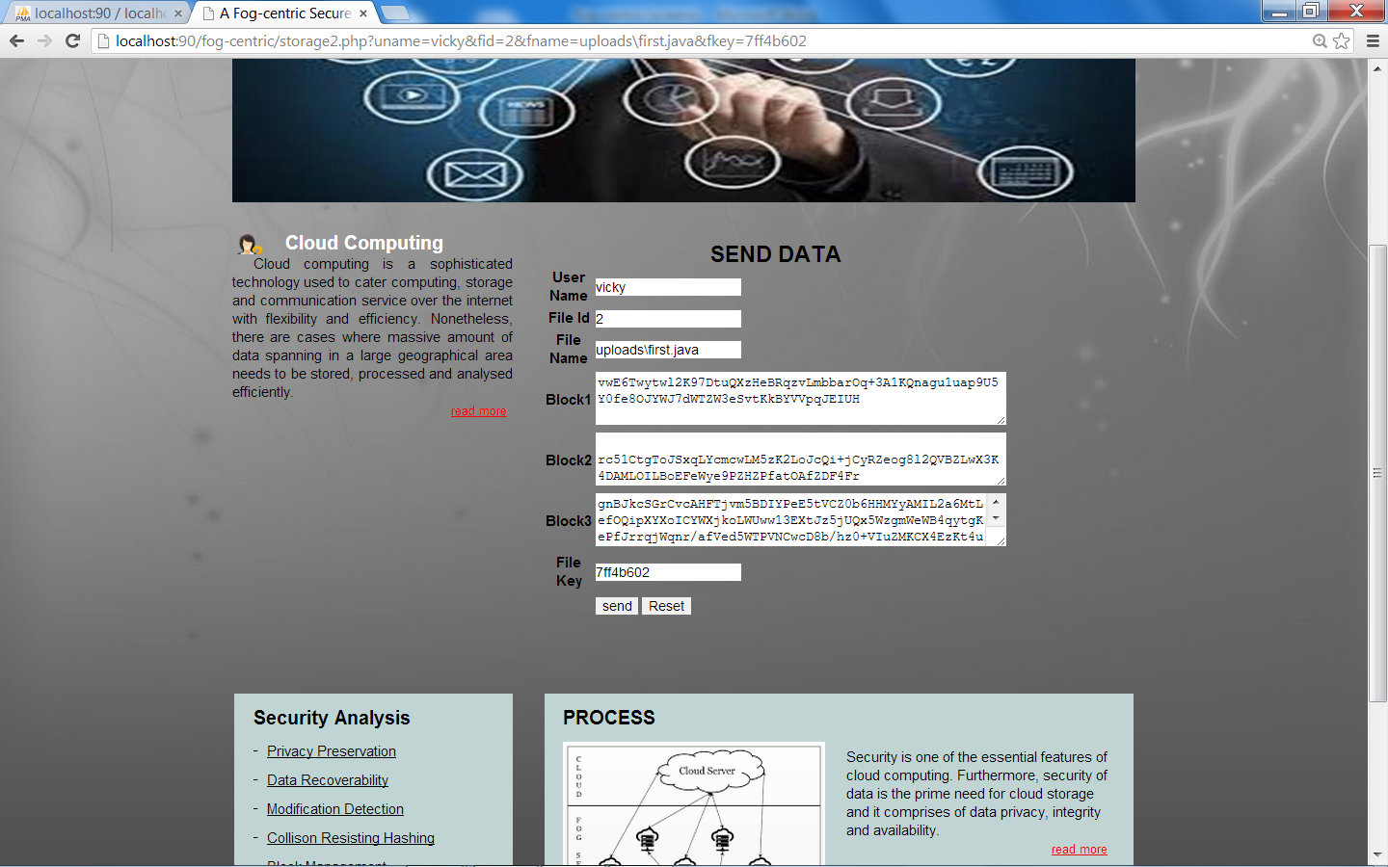
Send Data

Slide 27

Receive Data & Download

Slide 28
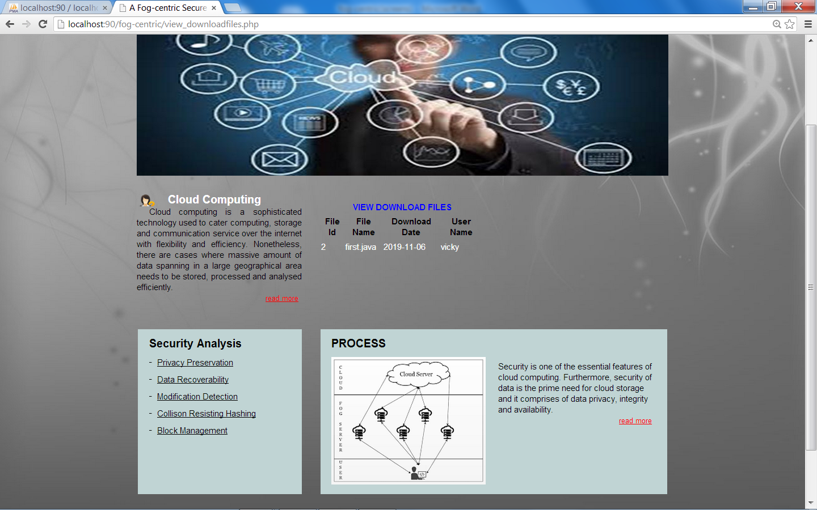
View Download File

Slide 29
Conclusion
Fog based three-layer architecture befits to a secure solution for robust cloud storage against cyber threats
. This project we proposed a scheme that undertakes preventive activities to a trusted fog server and puts the actual data in twisted format to multiple cloud servers.
We enhanced the efficiency of fog based cloud storage service. We improve the security of fog server for a robust fog centric cloud computing infrastructure.

Slide 30
FUTURE ENHANCEMENT
To enhance the efficiency of fog based cloud storage service.
To improve the security of fog server for a robust fog centric cloud computing infrastructure.
To enable cloud server to compute cryptic data without revealing any information from it.

Slide 31
Thank You

